Slide 1
Memory Design
Dr. Prapulla S B, Dept. of CSE,
RVCE, Bengaluru

Slide 2
Memory design
Most of the time, we need to realize/design Large size memory chips using smaller/available size memory chips.
Here the focus is how to design the required size RAM chips using available size memory /RAM chips.

Slide 3
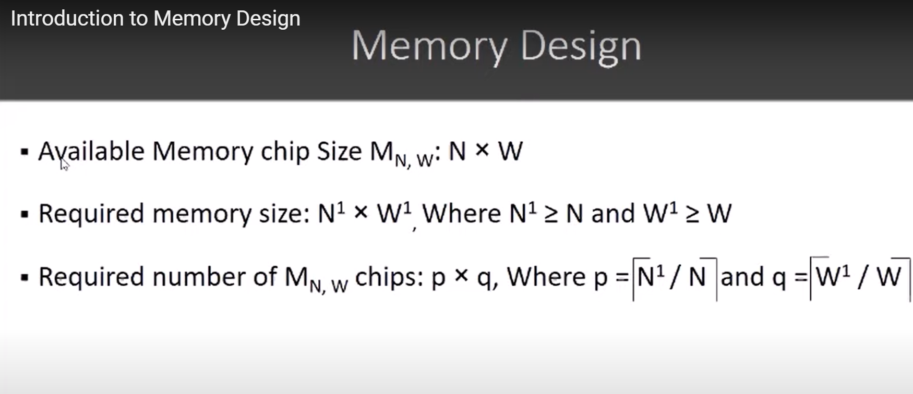

Slide 5
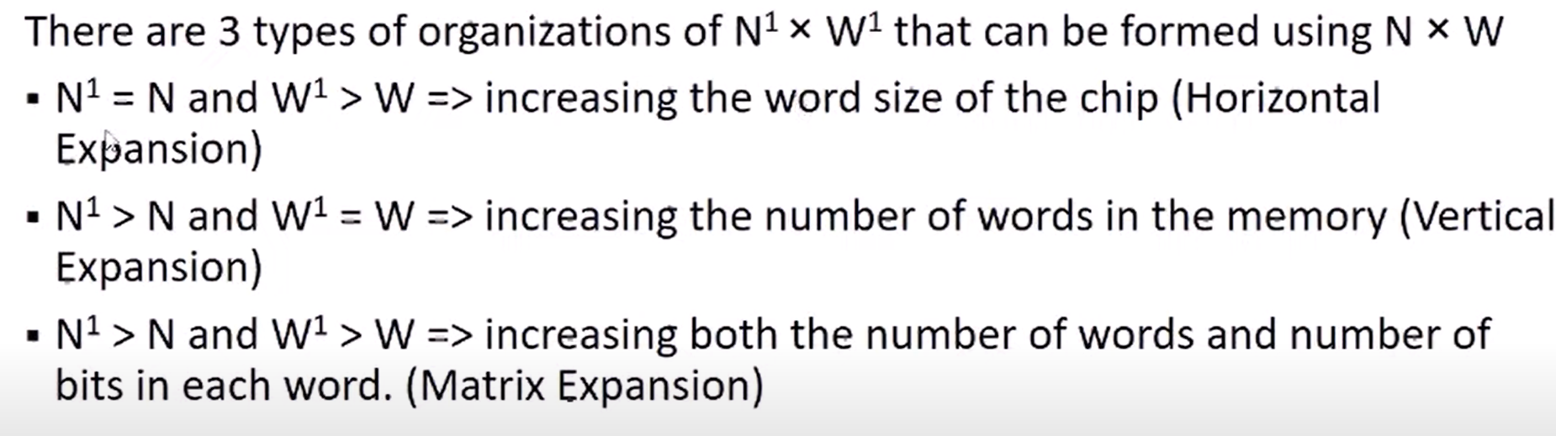
Three types of organisation-Horizontal, vertical and matrix expansion

Slide 6
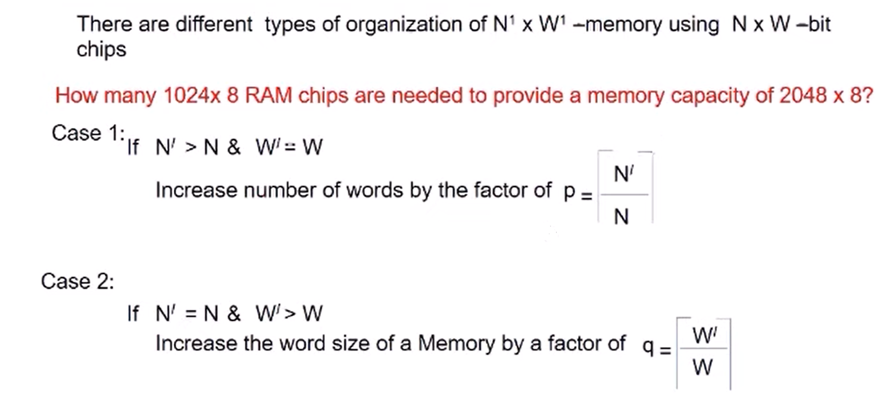
Vertical and horizontal expansion-example

Slide 7
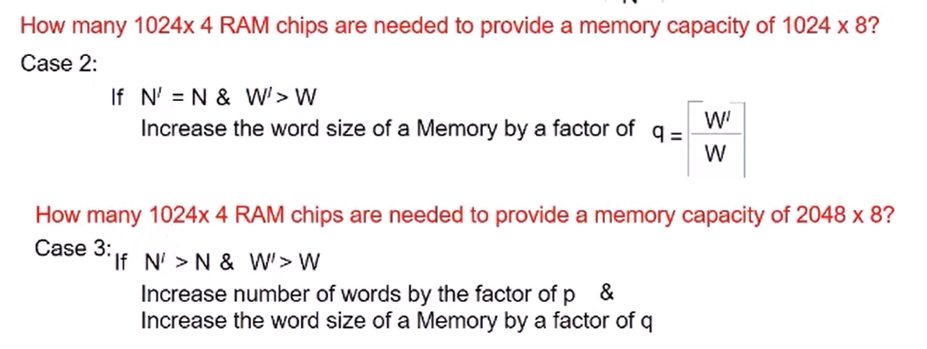
Matrix expansion -example

Slide 8
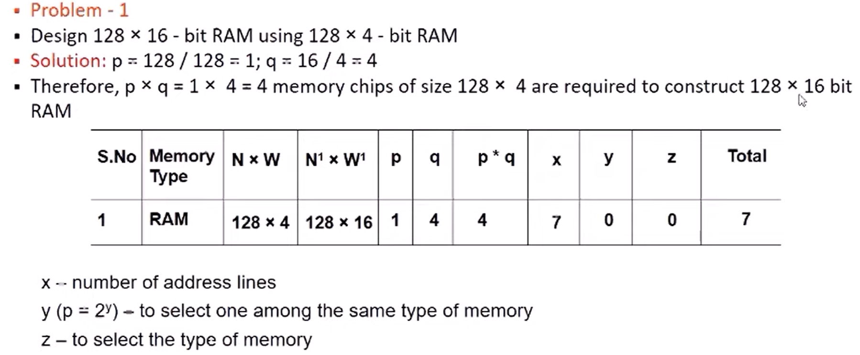
Mem design- horizontal expansion

Slide 9
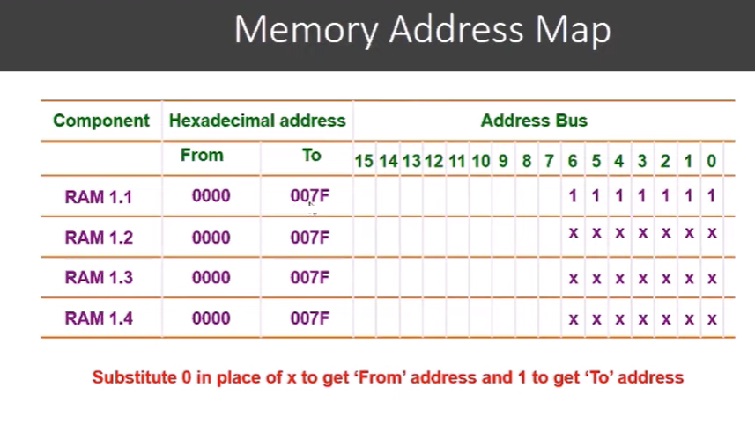

Slide 10
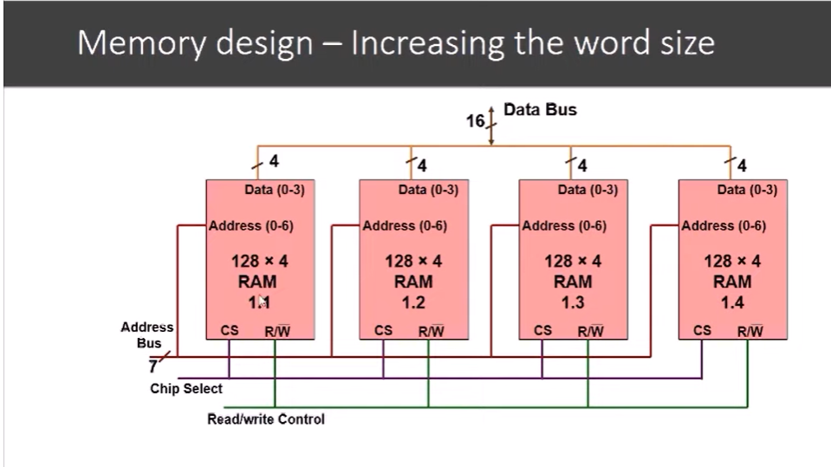

Slide 12
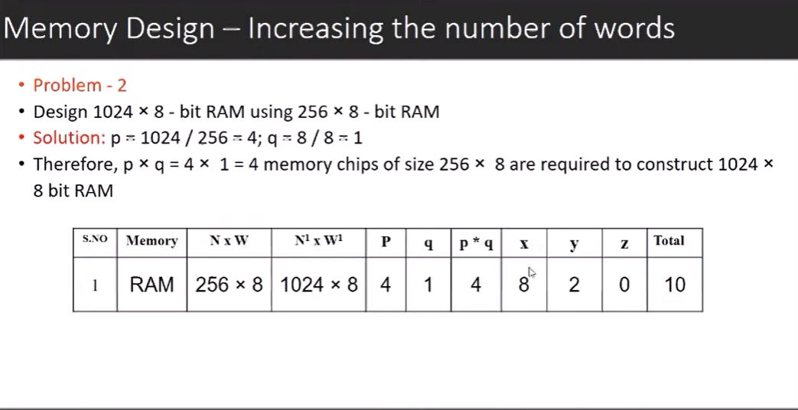
Mem design vertical expansion

Slide 14
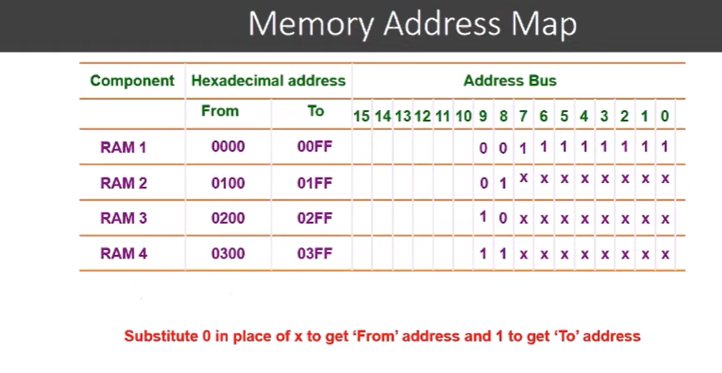

Slide 15
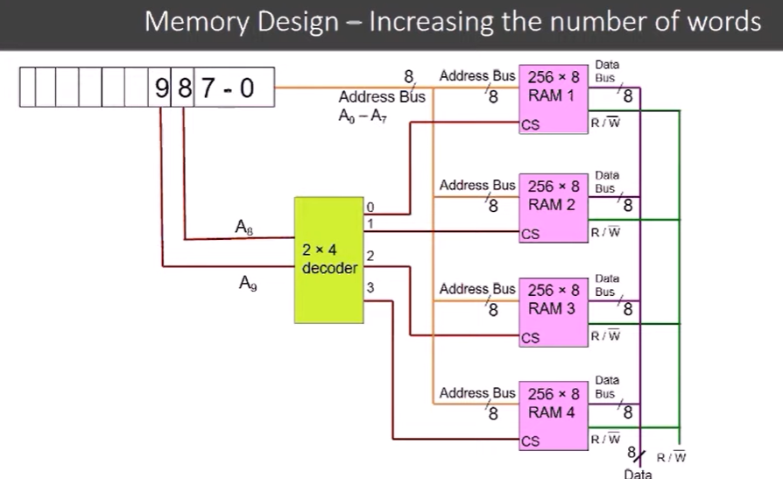

Slide 16
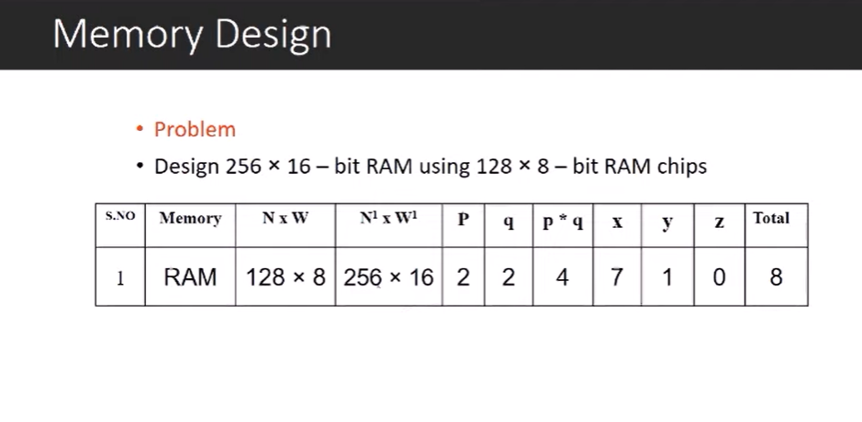
Memory design matrix expansion

Slide 18
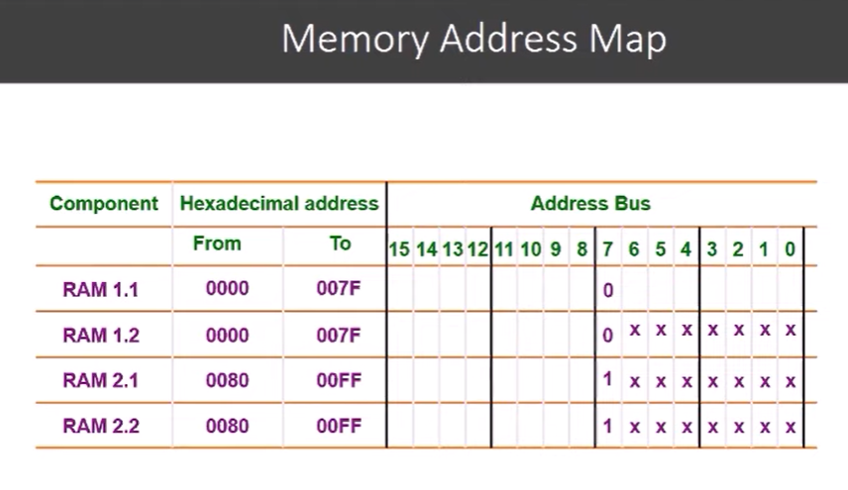

Slide 19
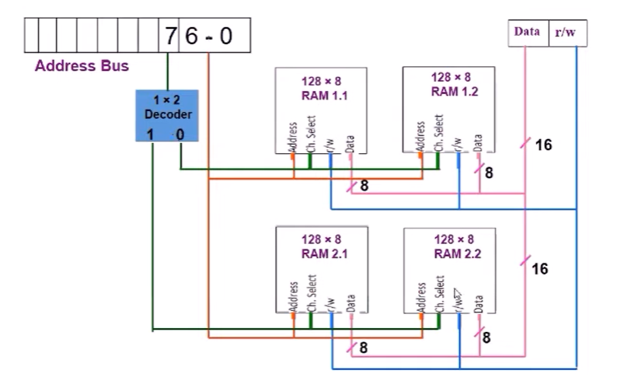

Slide 20
Design 512x8 ram using 128x8 ram
No. of chips required=desired ram size/basic ram size=
512x8/128x8=4x1= 4 chips
Address bits=512x8=2^9x8=9 bits
Decoder size=512/128=4. size of dec= 2 to 4 line decoder.
Design-

Slide 22
Design of 512×8 RAM using 128×8 RAM
Number of chips required = Desired RAM Size/ Basic RAM Size =512x8/128x8 =4 chips
Required Size is 512 x 8 , 512 x 8= 2⁹ x 8 Therefore, 9 bit address is required
Size of decoder= number of times words increasing 128⇢512 words increased by 4 times Decoder Size= 2x4

Slide 23
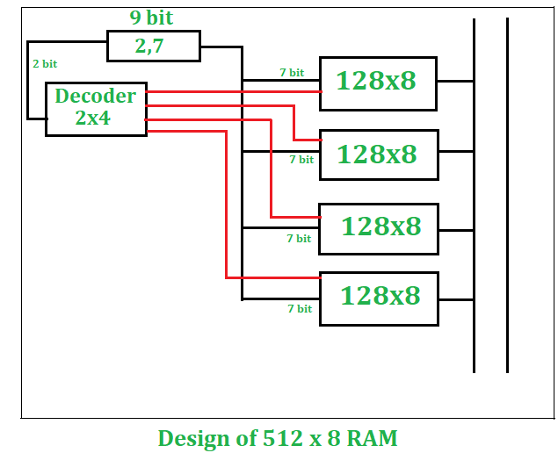

Slide 24
RAM 32 X 8 using 16x4
16 X 4 memory contains 4 output lines. there is also a 4-bit input to construct the 16 WORDS.
No of chips reqd=(32x8)/(16x4)=2x2=4 chips
No. of address bits= 32x8=2^5= 5 address bits
Size of decoder=32/16=2, so require 1 to 2 line decoder.

Slide 25
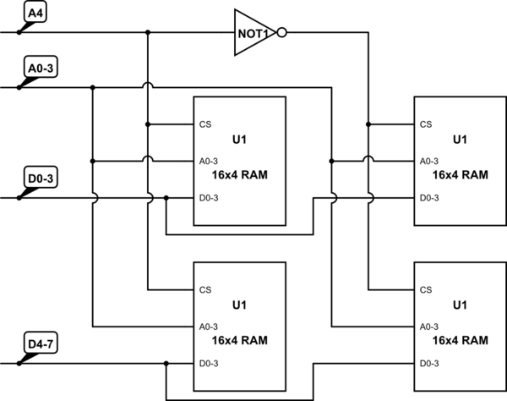
Design for 32x8 using 16x4 RAM

Slide 28
Assignment

